Slide 1
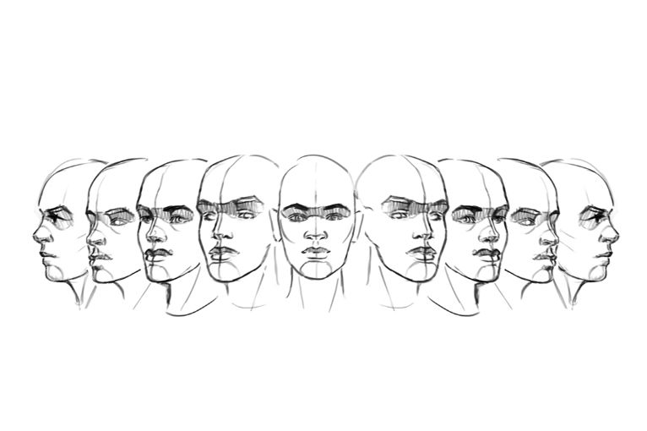
Single to multiple profile generation of a face using conditional GANs
Group 5: Parth Goel (pg514)

Slide 2
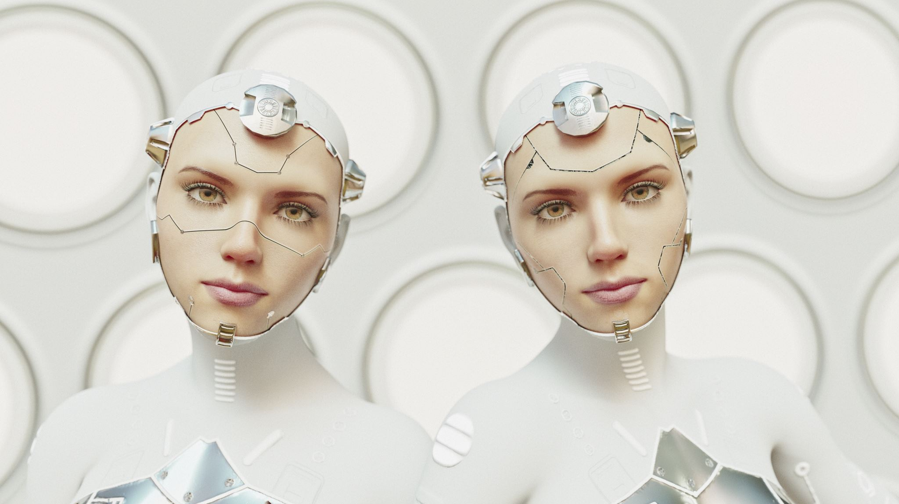
Aim
Implement an image translation model for generating multiple profiles (0º, 45º, 135º, 180º) of a face given a single profile (center profile i.e., 90º).
Use Conditional Generative Adversarial Networks to build 4 models, one for each profile.

Slide 3
Motivation
Aid the police and other security firms in searching for wanted criminals and missing people.
Have some fun among our peers.

Slide 4

Dataset
We have combined two datasets for this project
KDEF
CVL Faces Database

Slide 5
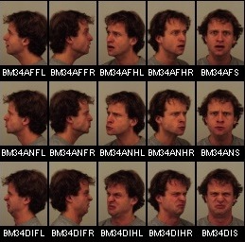
KDEF Dataset
4900 images of 70 individuals, having 7 different facial expressions from 5 different angles.
All the images are of 562 x 762 pixels.

Slide 6
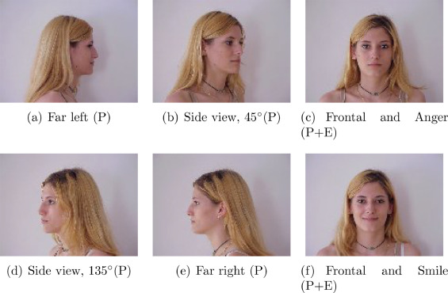
CVL Faces Database
798 images of 114 individuals, having 3 different facial expressions from 5 different angles.
All the images are of 640 x 480 pixels.

Slide 7

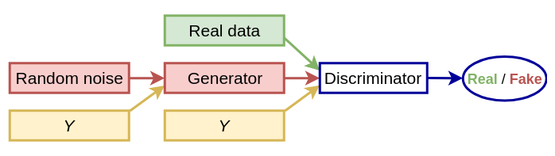
Algorithm
GANs are generative models that learn a mapping from random noise vector z to output image y, G:z. y.
CGANs learn a mapping from observed image x and random vector z to y, G:x,z y.

Slide 8
Programming Language & Software Tools
Programming Language: Python
Libraries Used: Pytorch, OpenCV, Mediapipe, Numpy, Matplotlib and Tkinter
Tools: Rutgers iLab, Jupyter Notebook and Adobe Photoshop

Slide 9
Data Preprocessing
Cropped the extra pixels from the sides in the CVL faces database and reshaped the images to 354 x 480 pixels.
Discarded extra images in the CVL faces database.
Generated missing images in KDEF dataset using Photoshop.
Changed the background of all the images to white using selfie segmentation model of Mediapipe and Photoshop.
After preprocessing and combining, got 5470 images occupying 1.07 GB memory.

Slide 10

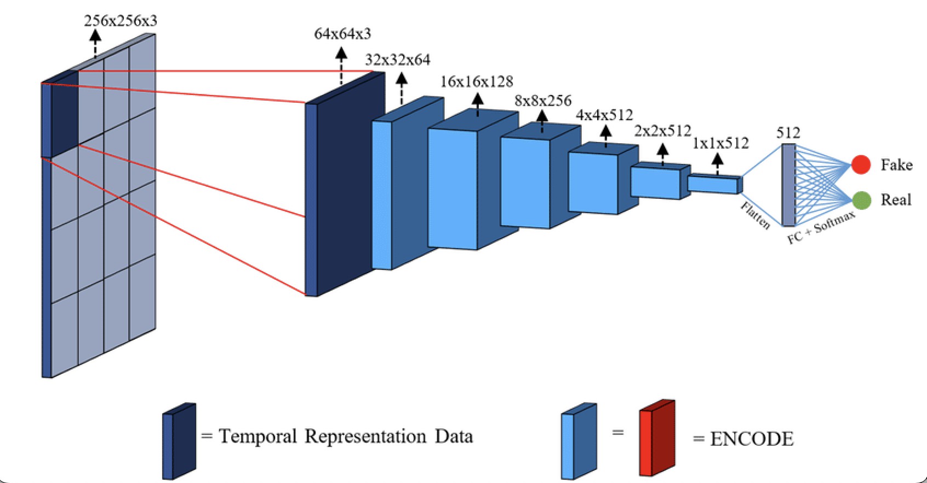
Network Architecture
U-net Architecture for Generator
286 x 286 PatchGAN Architecture for Discriminator

Slide 11
Hyper Parameters
Batch Size: 16
Loss: Adversarial Loss and L1 loss
Optimizer: Adam
Learning Rate: 0.0002 with betas (0.5, 0.999)
Alpha: 100 (multiplying factor for the L1 loss)
Epochs: 200
Train-Test Split: 1089:5
Input and Output shape of images: 256x256x3

Slide 12
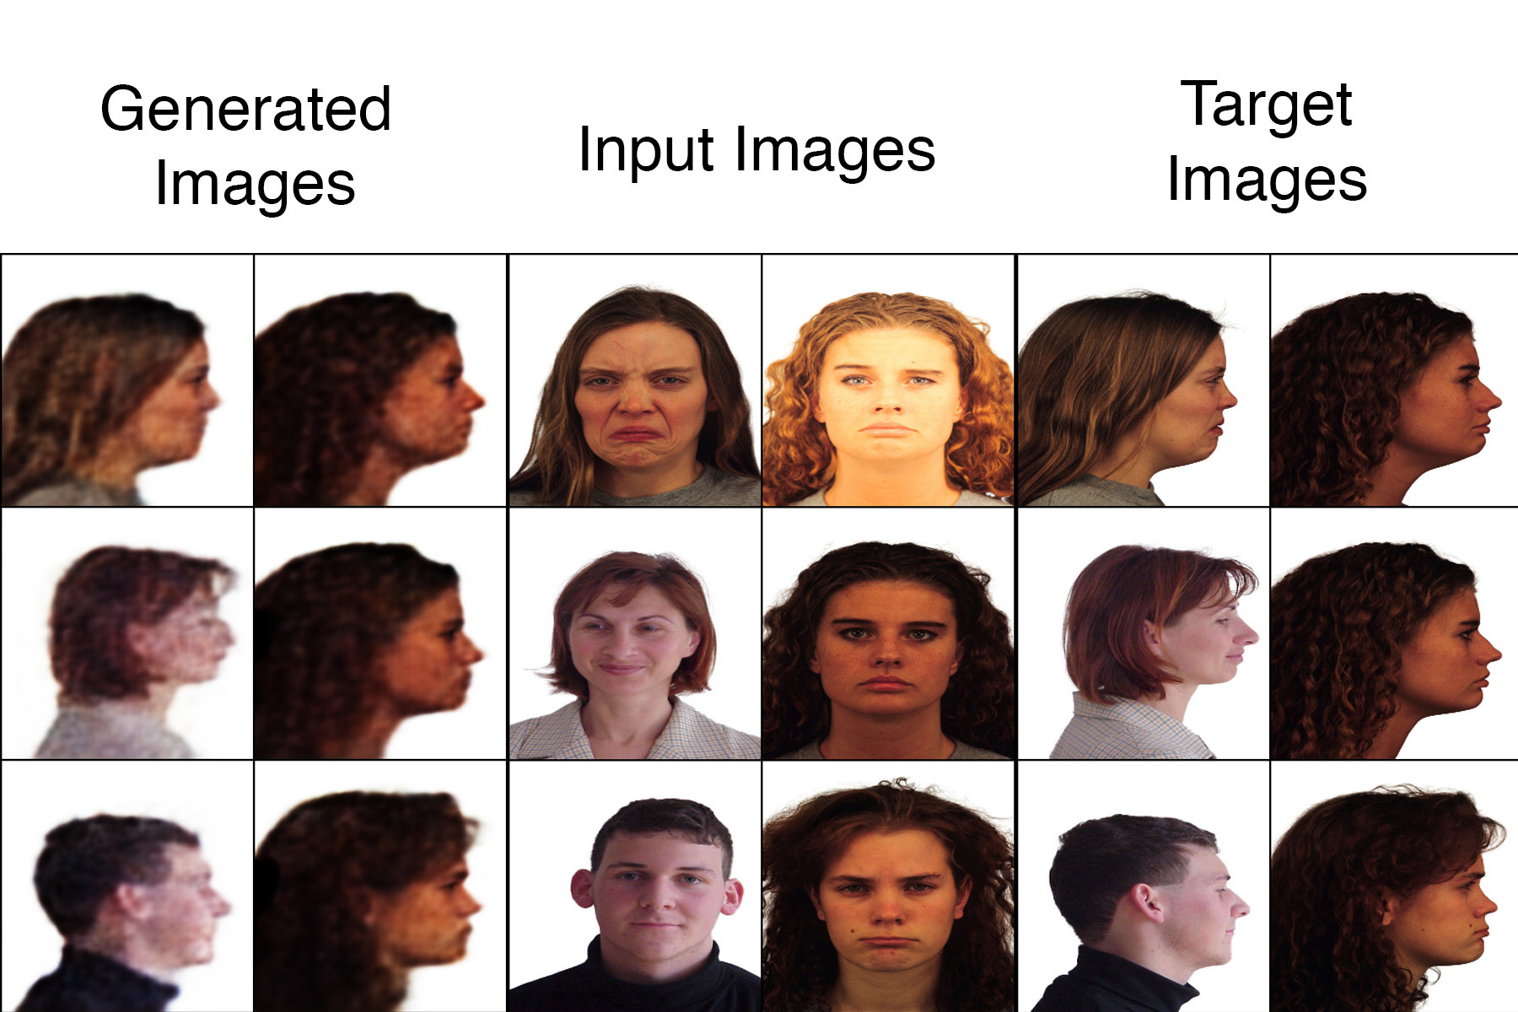
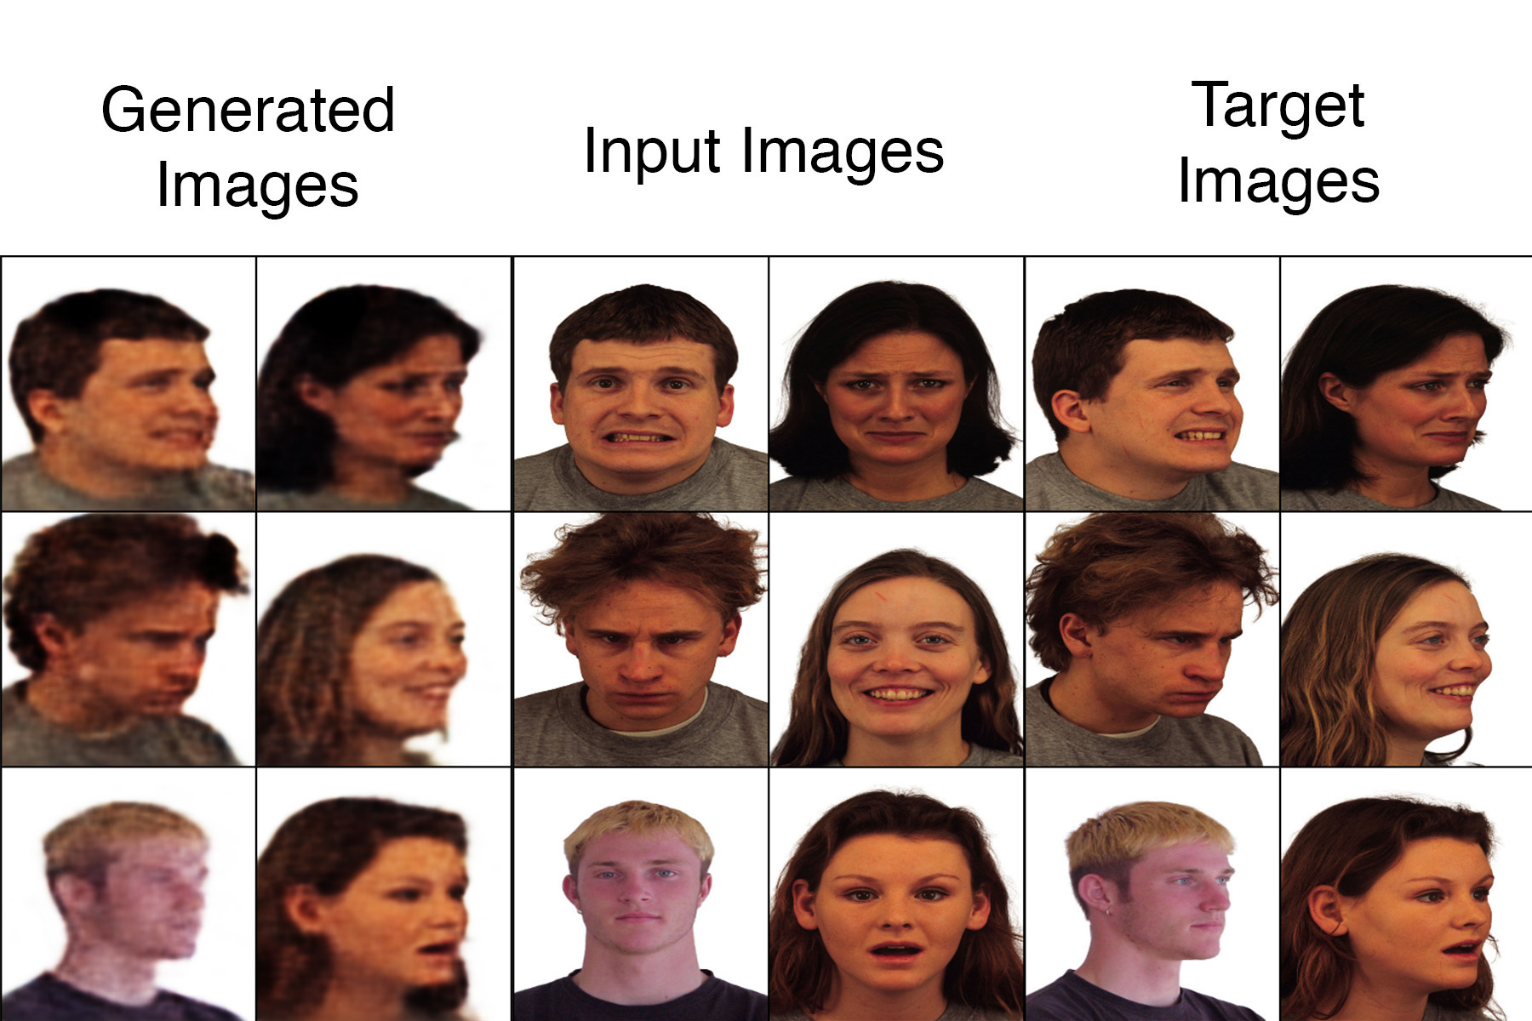
Training Results
200th epoch training images for 0º model
200th epoch training images for 45º model

Slide 13
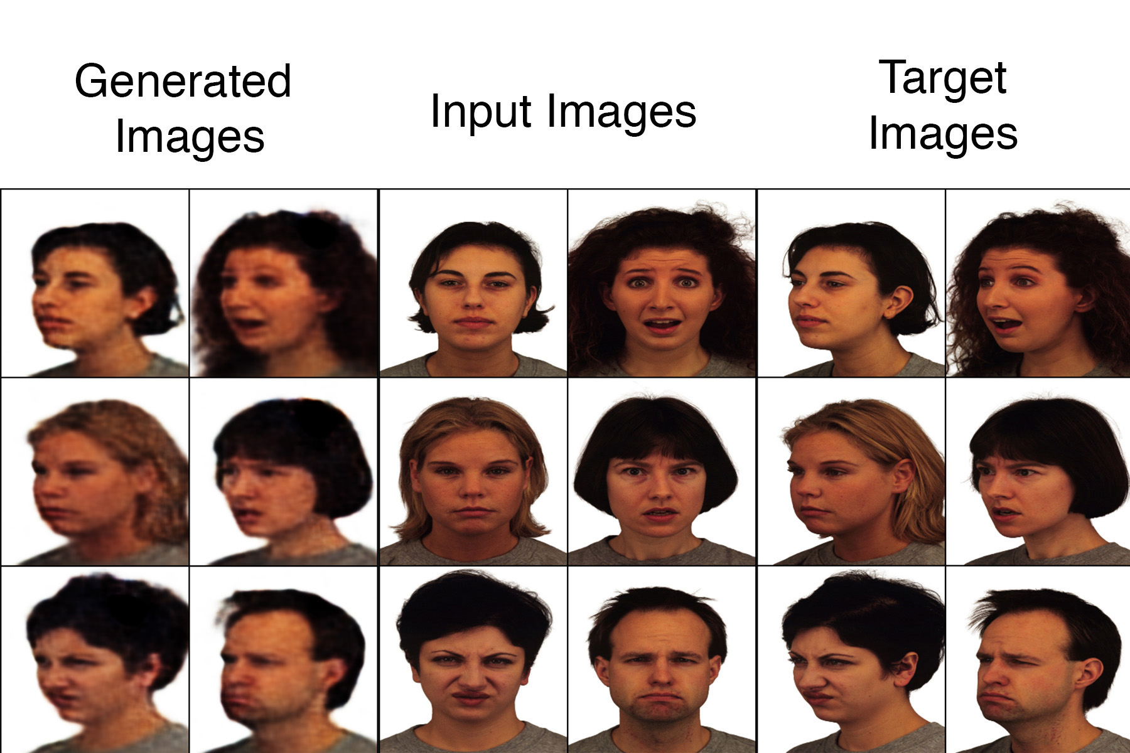
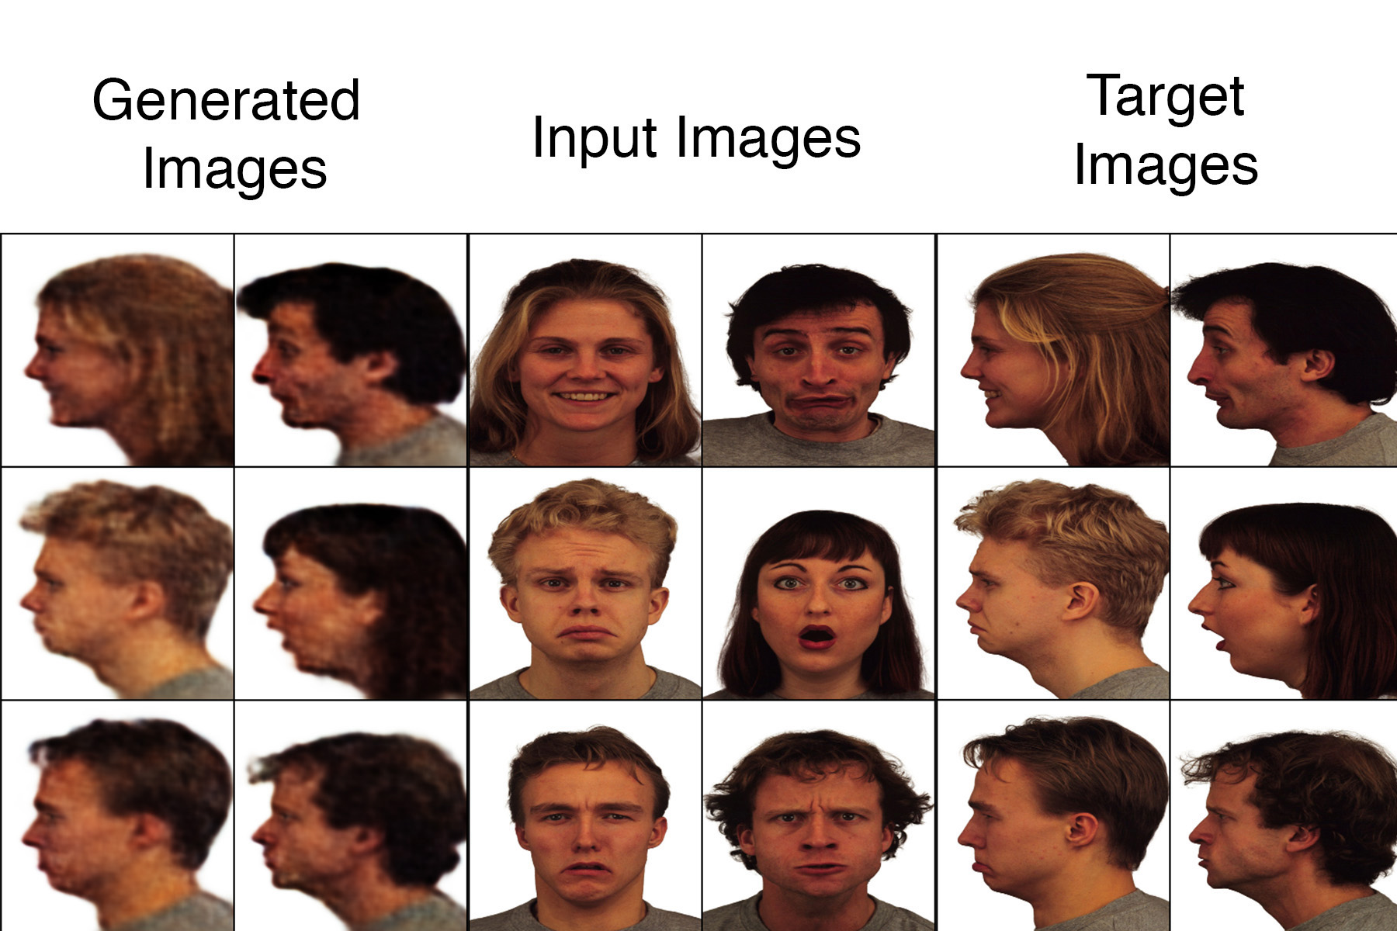
Training Results
200th epoch training images for 135º model
200th epoch training images for 180º model

Slide 14
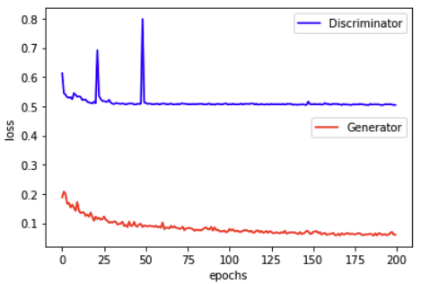
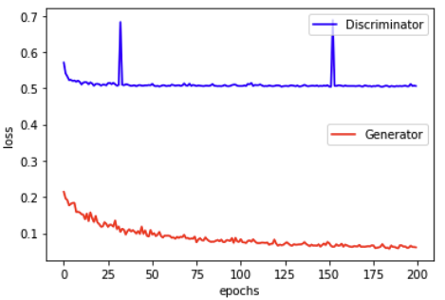
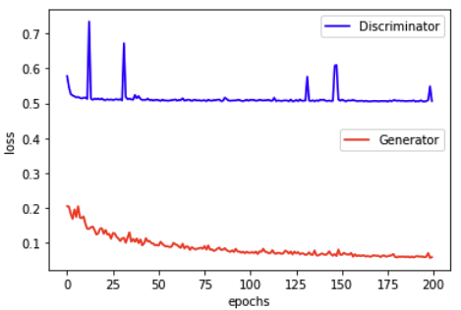
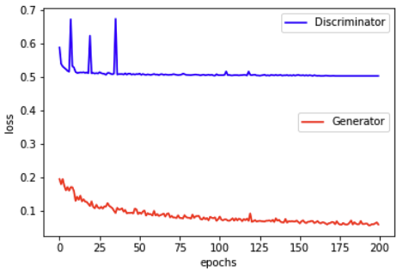
Evaluation Graphs
Loss Plots of 0º, 45º, 135º, 180º models

Slide 15
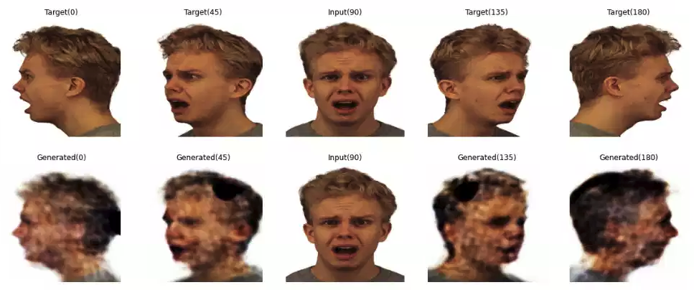
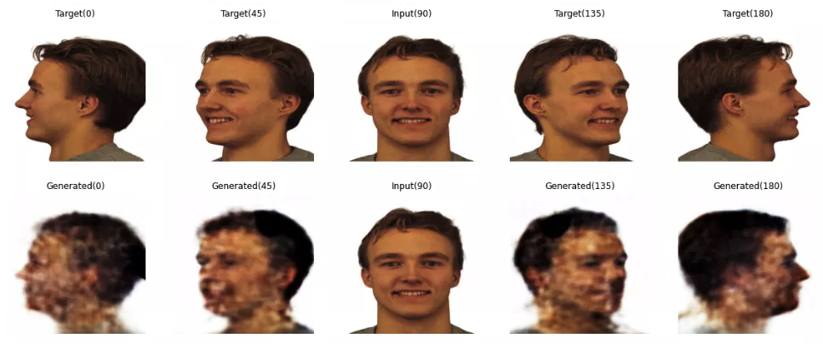
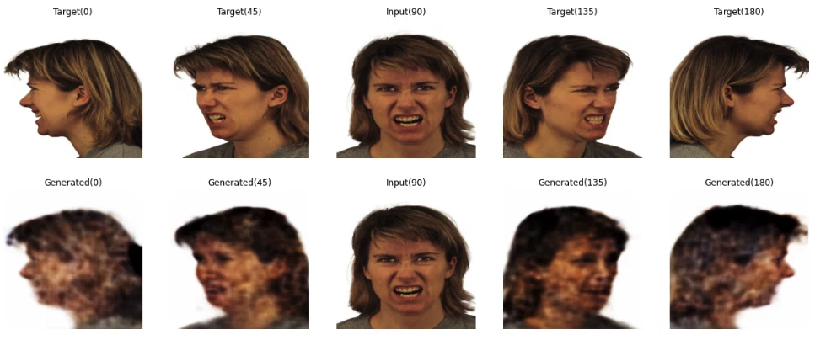
Test Results
From the test set

Slide 16
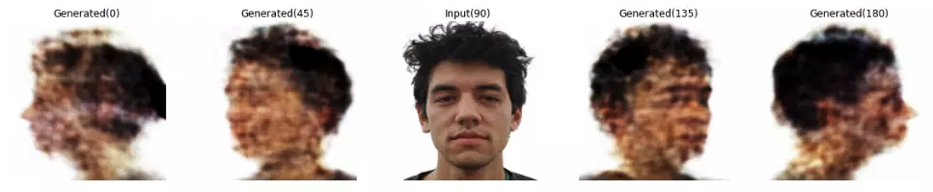
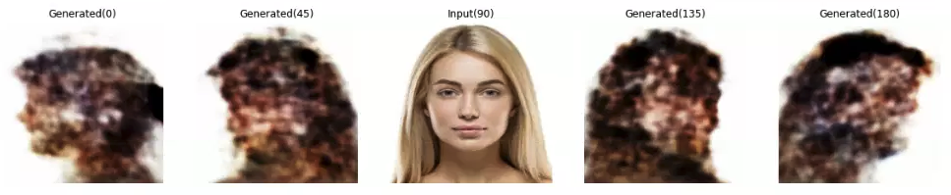
Test Results
From the web

Slide 17
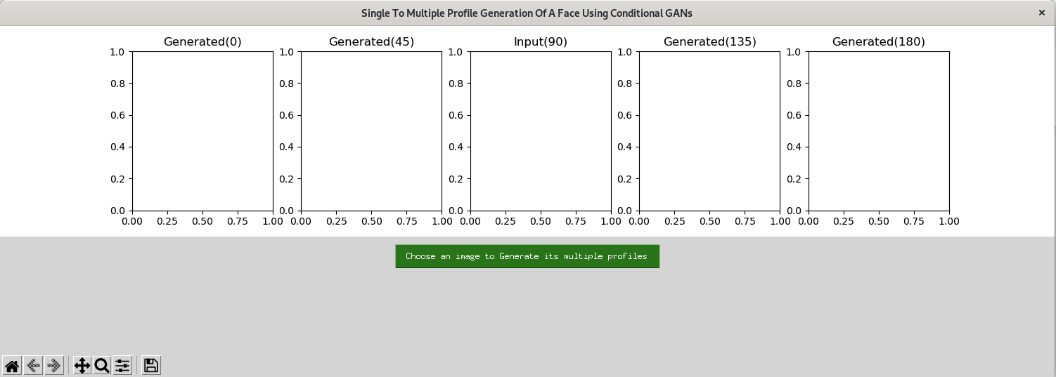
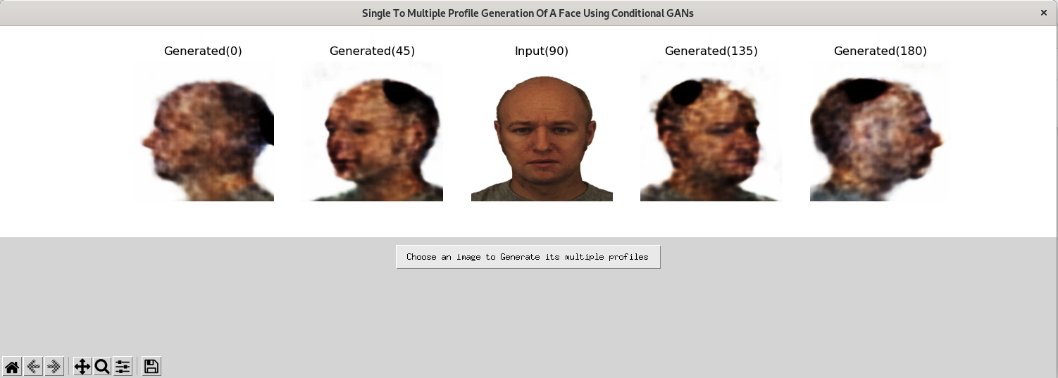
GUI using Tkinter

Slide 18
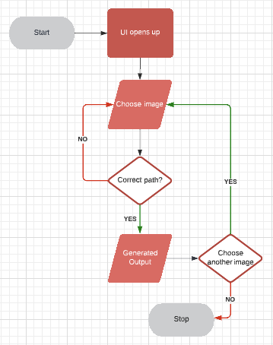
Flowchart of the application

Slide 19

Challenges Faced
Gathering the dataset
Cleaning the dataset
Preprocessing the dataset
Reading and understanding the pix2pix paper
Trying different architectures for Discriminator
Building the GUI using Tkinter

Slide 20
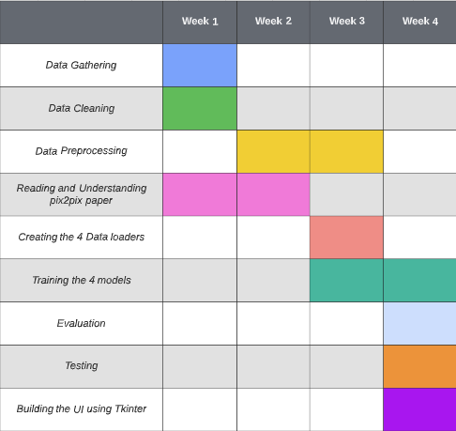
Division of Work and timeline
Gantt Chart

Slide 21
Conclusion and Future Work
In conclusion our project did a good job being a prototype, working with limited data with very little diversity. It gave us good results for the training and test images of the dataset, but mixed results on the images from the web.
For future work, we’d like to train our models on a bigger dataset which has more diversity, meaning it has people from different ethnicity.

Slide 22
References
[1] Isola, Phillip, et al. “Image-To-Image Translation with Condi- tional Adversarial Networks.” ArXiv:1611.07004 [Cs], 26 Nov. 2018, arxiv.org/abs/1611.07004v3. Accessed 16 Nov. 2022.
[2] E.Lundqvist, D., Flykt, A., and O ̈hman, A. (1998). The Karolinska Directed Emotional Faces - KDEF, CD ROM from Department of Clinical Neuroscience, Psychology section, Karolinska Institutet, ISBN 91-630-7164-9.
[3] Langner, Oliver, et al. “Presentation and Validation of the Radboud Faces Database.” Cognition and Emotion, vol. 24, no. 8, Dec. 2010, pp. 1377–1388, 10.1080/02699930903485076.
[4] PEER,Peter,EMERSˇICˇ,Zˇiga,BULE,Jernej,ZˇGANECGROS,Jerneja, SˇTRUC,Vitomir.Strategiesforexploitingindependentcloudimplemen- tations of biometric experts in multibiometric scenarios. Mathematical problems in engineering, vol. 2014, pp. 1-15, 2014.
[5] Taherkhani, Fariborz, et al. “Profile to Frontal Face Recognition in the Wild Using Coupled Conditional GAN.” ArXiv:2107.13742 [Cs], 29 July 2021, arxiv.org/abs/2107.13742. Accessed 16 Nov. 2022.

Slide 23

Thank You

